Slide 1
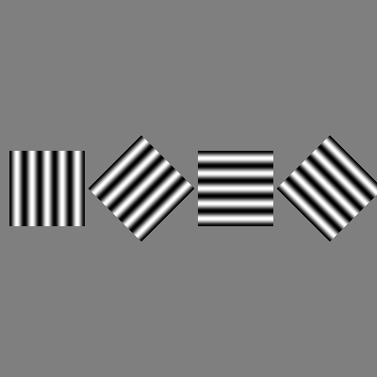
Investigating neural response to orientation in static and drifting gratings
Tommaso Ferracina
Umut Tuna Akgul
Tebe Nigrelli
George Morris
Utku Bahcivanoglu

Slide 2
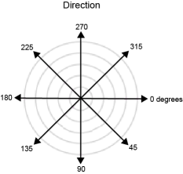
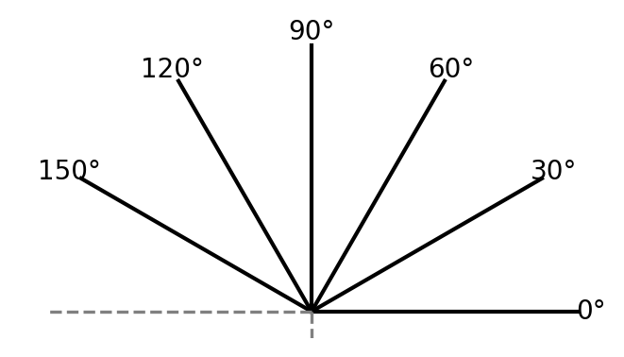
Refresher on static and drifting gratings
Static gratings:
6 orientations
Varied spatial frequencies and phases
Drifting gratings:
8 orientations (4 but with different directions)
Varied Temporal frequencies

Slide 3
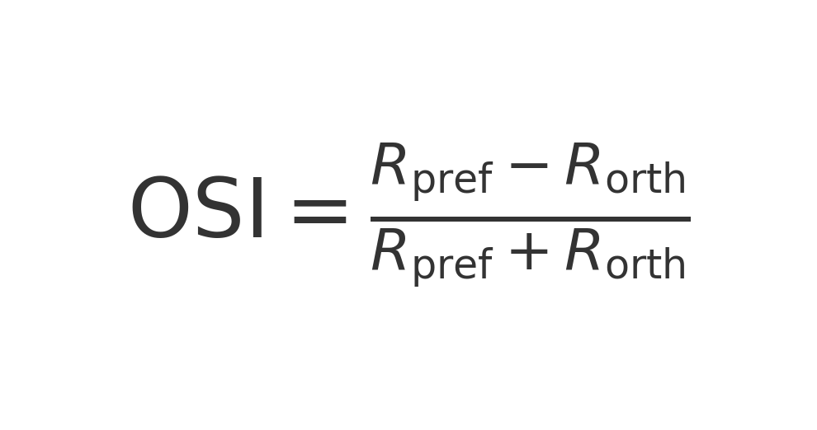
Orientation-Selective criteria
We look for orientation selective neurons for both static and drifting stimulus, to do this we define two criteria a neuron must satisfy for us to deem it as orientation-selective.
High Orientation-Selectivity Index (OSI > 0.5)
Statistically significant orientation tuning (ANOVA p-value <0.05)
- H0: Neurons possess equal mean spike counts across all orientations
- One-way ANOVA for each unit

Slide 4
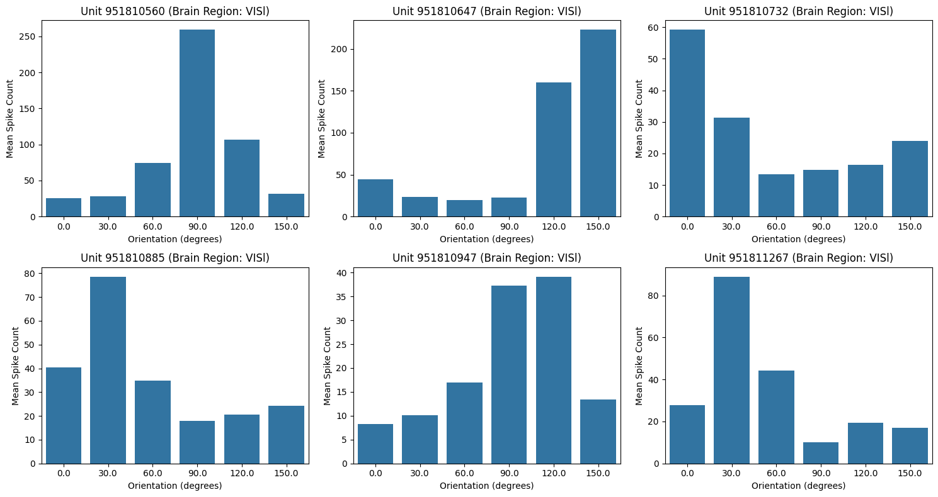
Orientation-Selection results for static
Identified 43 responsive units mainly in VISal and VISl of the visual cortex
Anatomical distribution matches known mouse brain orientation pathways.
Tuning curves show both narrowly and broadly tuned neurons.
Diverse response profiles aid in distinguishing visual orientations.
Findings align with hierarchical orientation processing in vision areas.

Slide 5
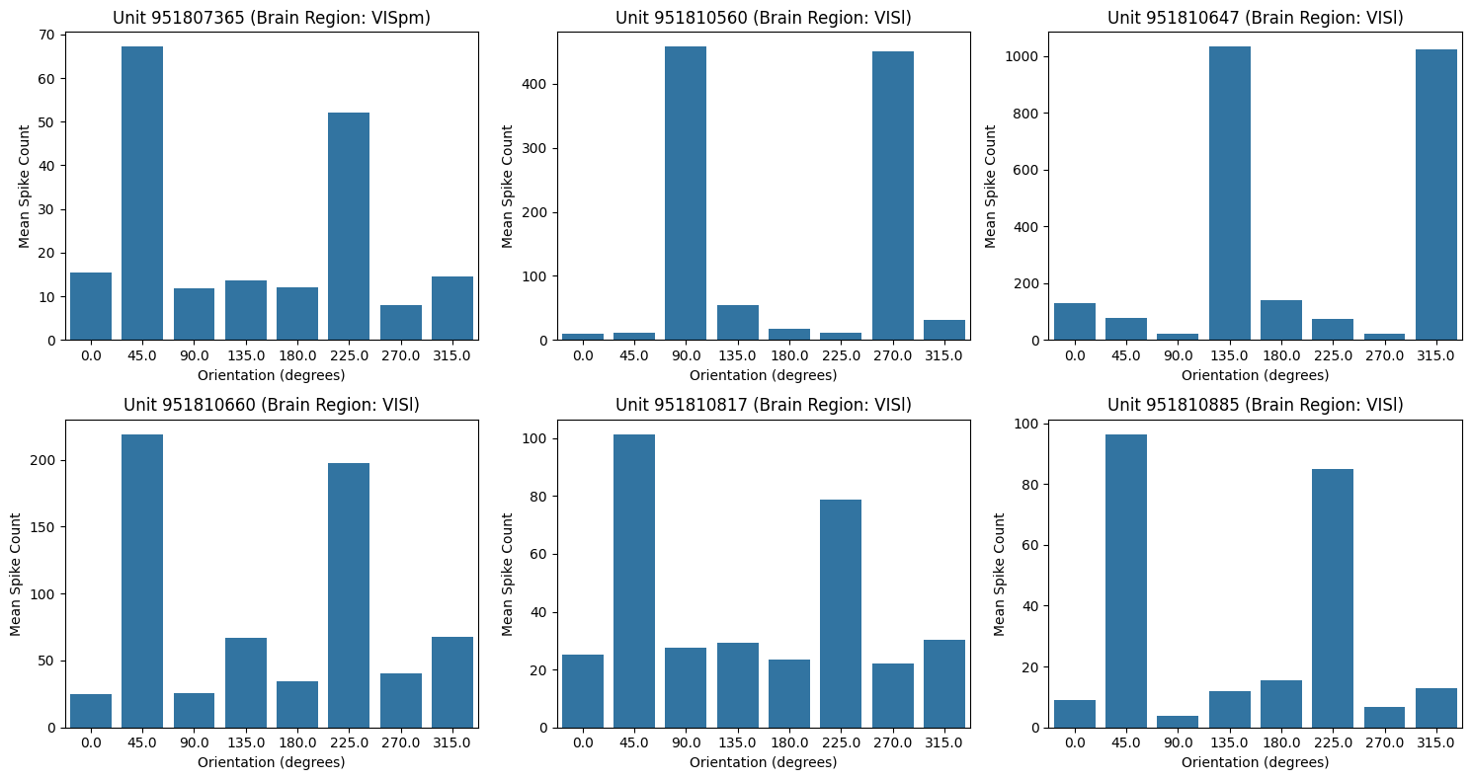
Orientation-Selective results for drifting
The criteria yielded 81 orientation-selective neurons, similarly all in the visual cortex except one in ‘grey’.
Higher OSI values (0.8–1.0) observed compared to static stimuli.
All in visual cortex; bar one found in grey matter.
Tuning curves had sharper peaks, likely due to full 360° stimulus range.
Only 8 units showed high DSI, indicating orientation-based rather than motion-based response.

Slide 6
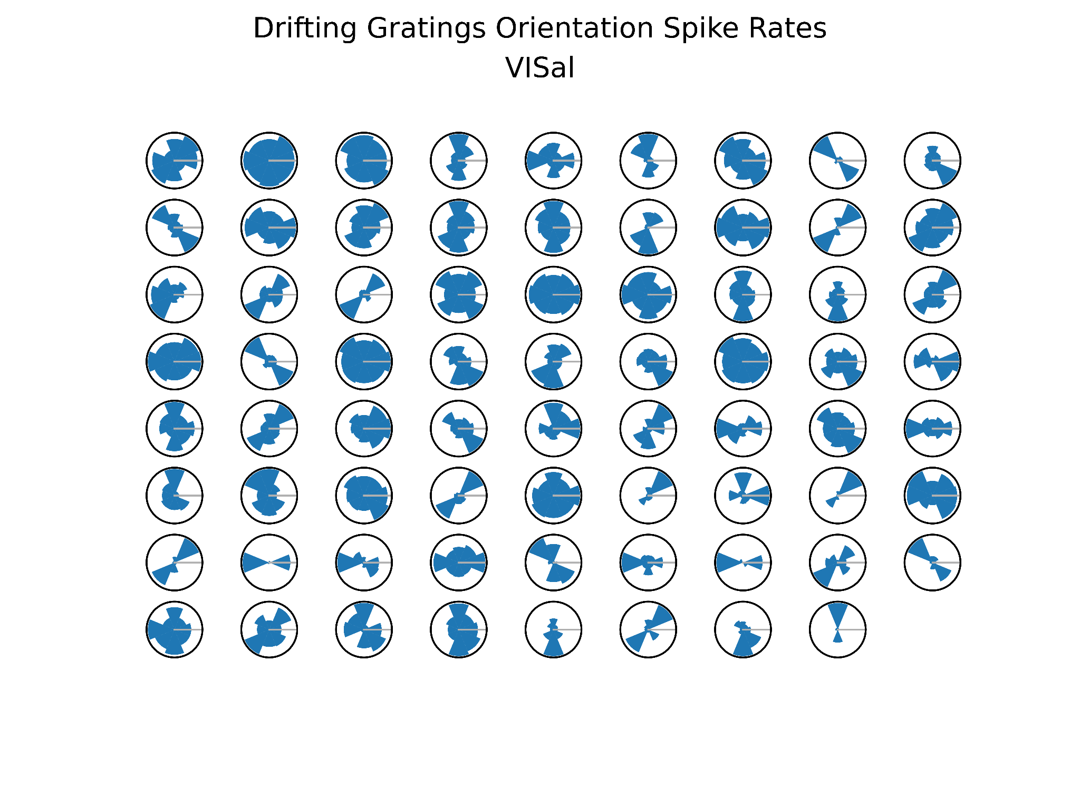
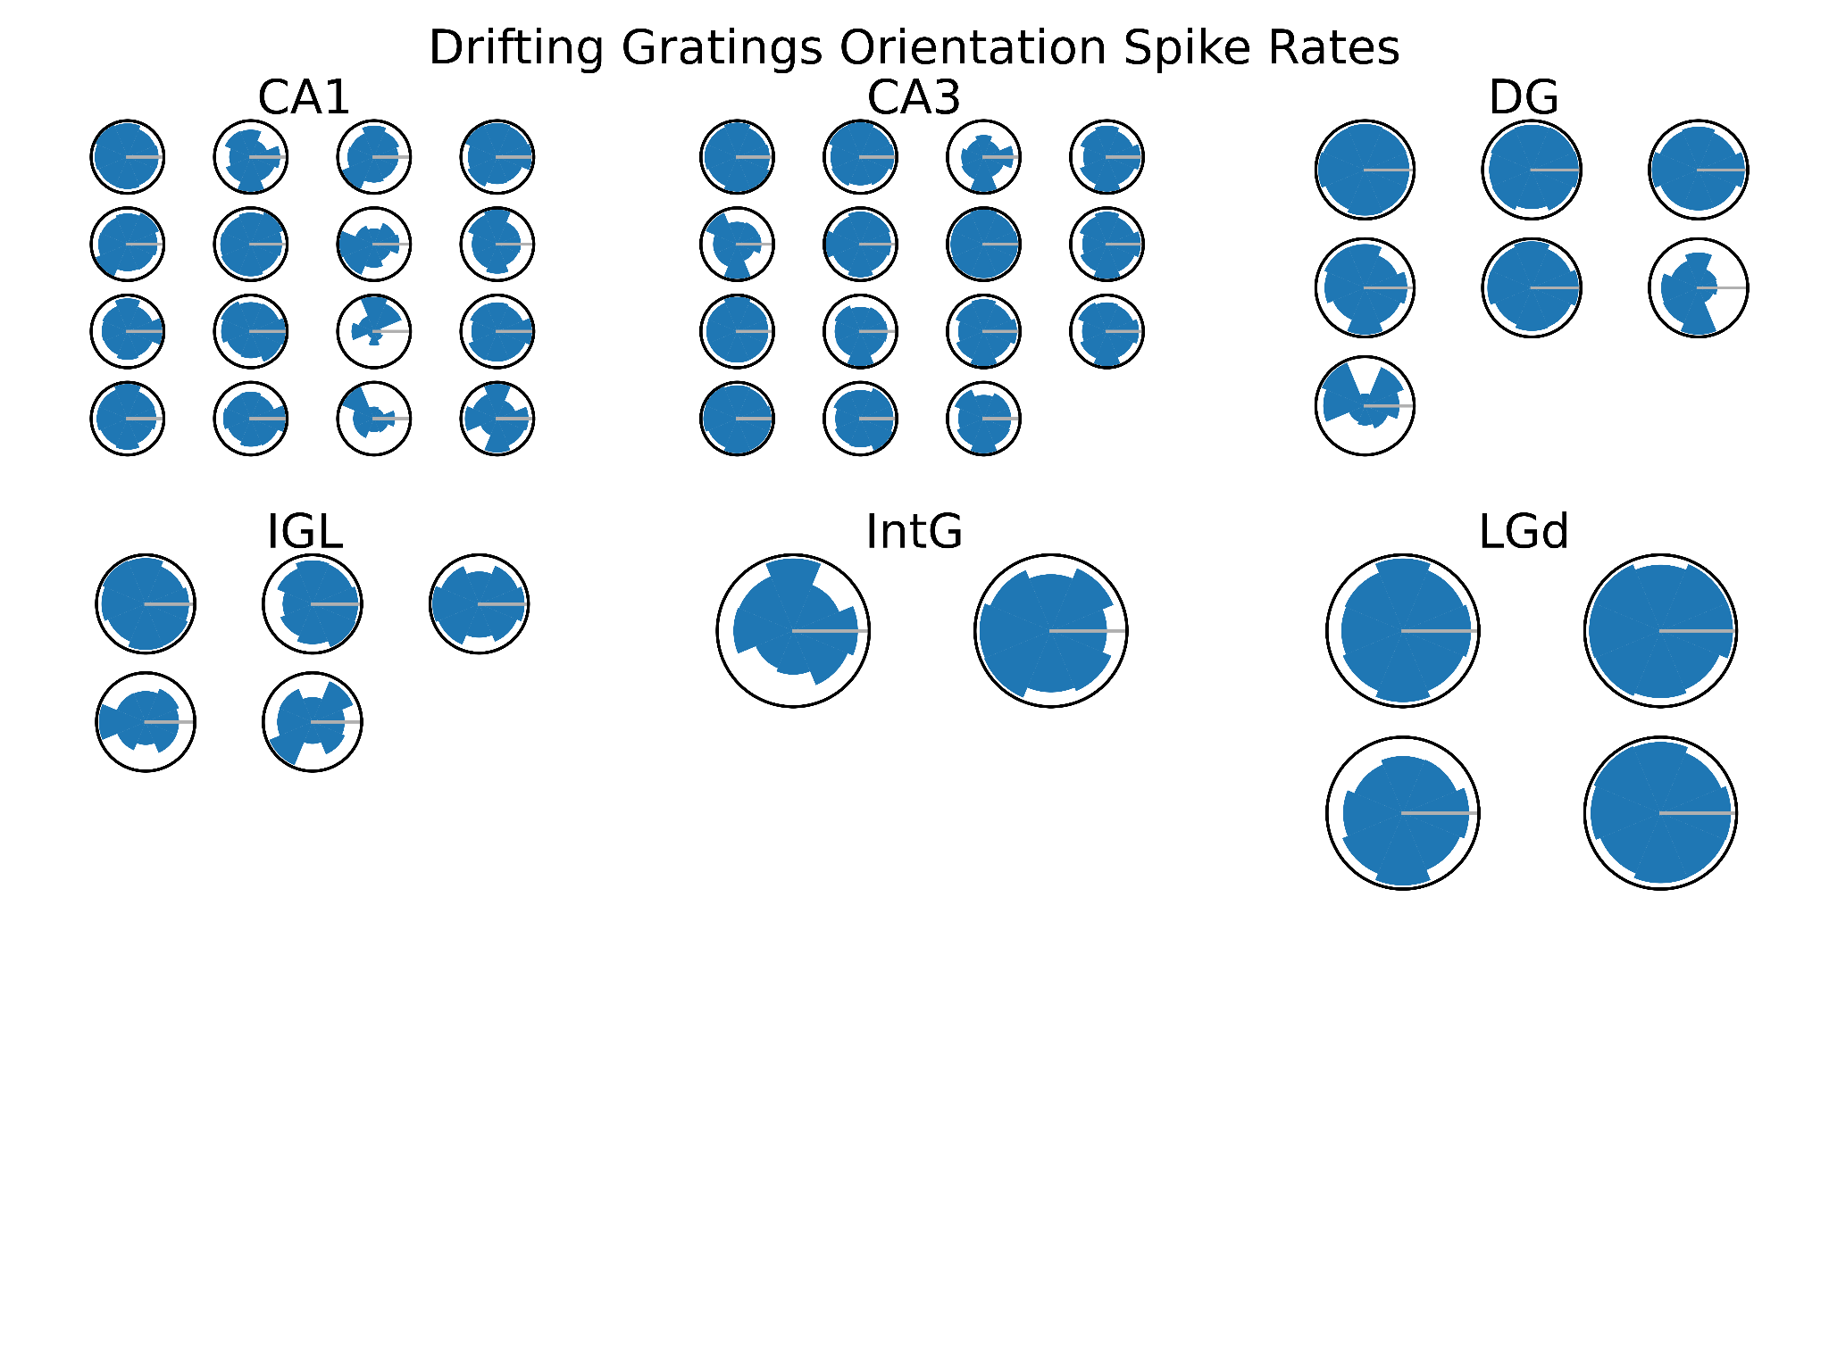
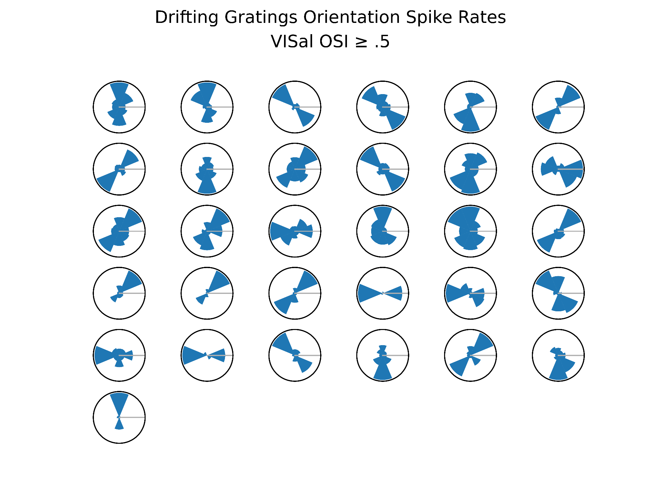
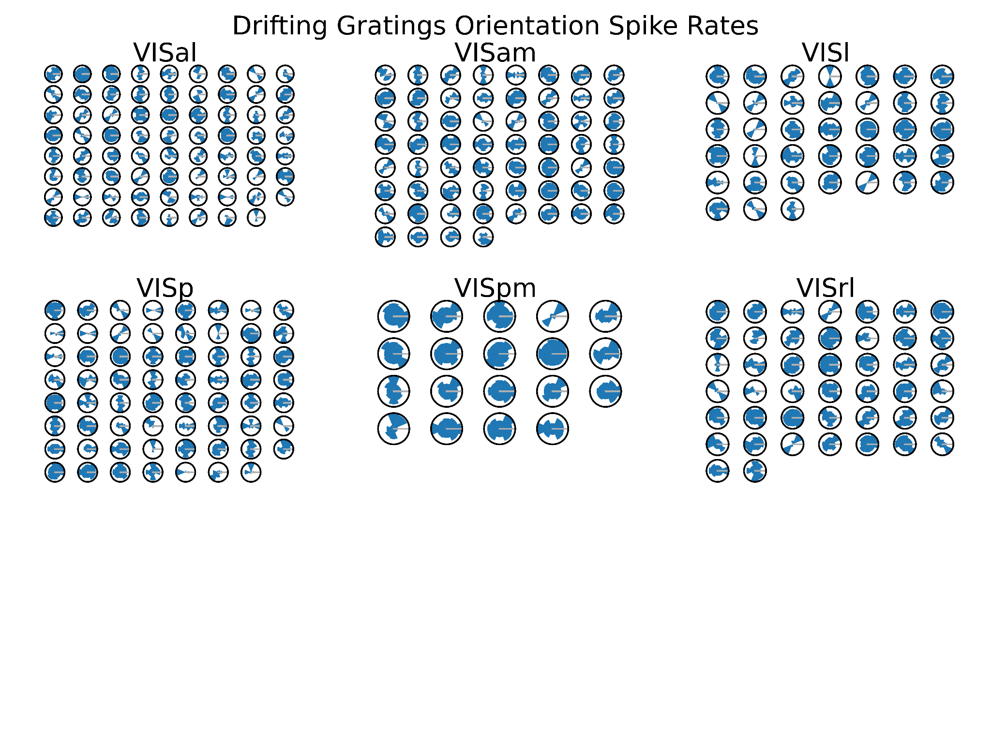
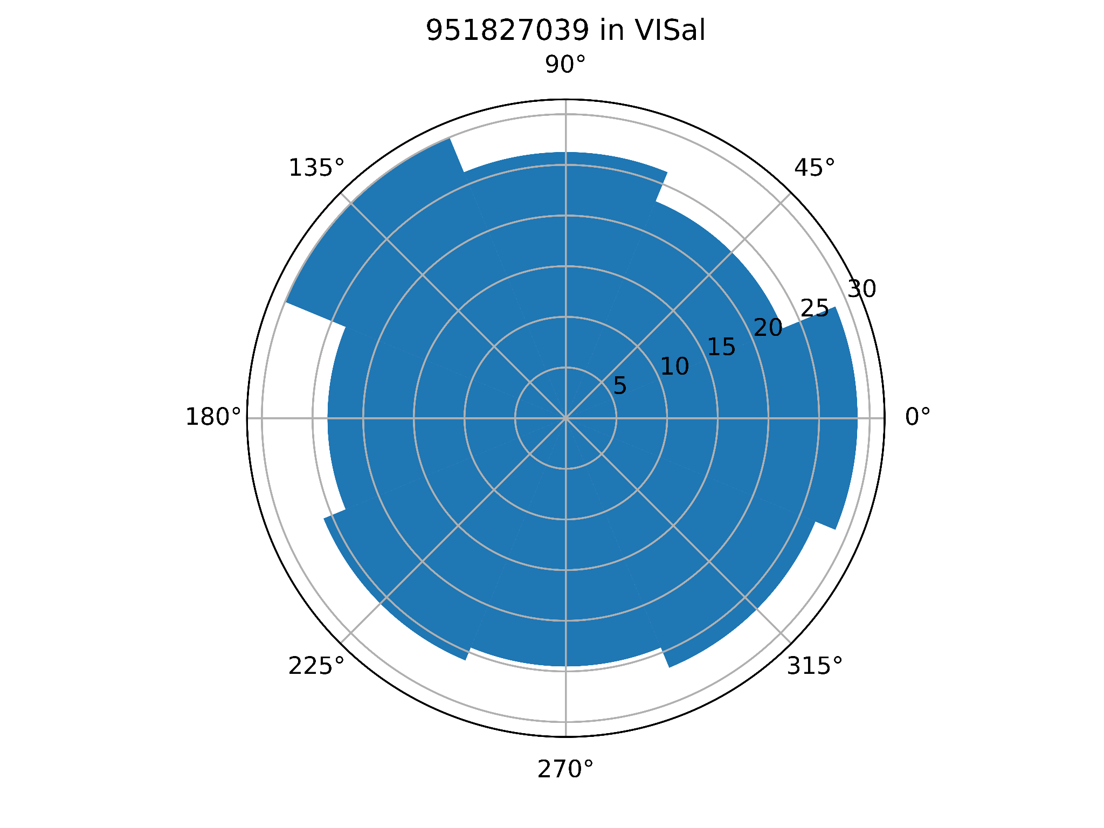

Visualization of spike rate vs. orientation
Units outside the visual cortex show little or no reaction to orientation.
Units in the visual cortex sometimes show little reaction to orientation.
Some units in the visual cortex act only on opposite directions.
These unit usually have high OSI.

Slide 7
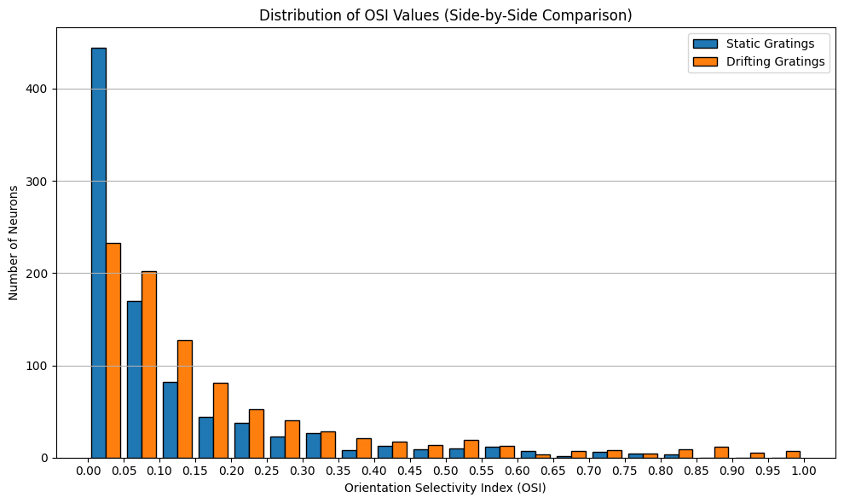

Cross condition analysis

Slide 8
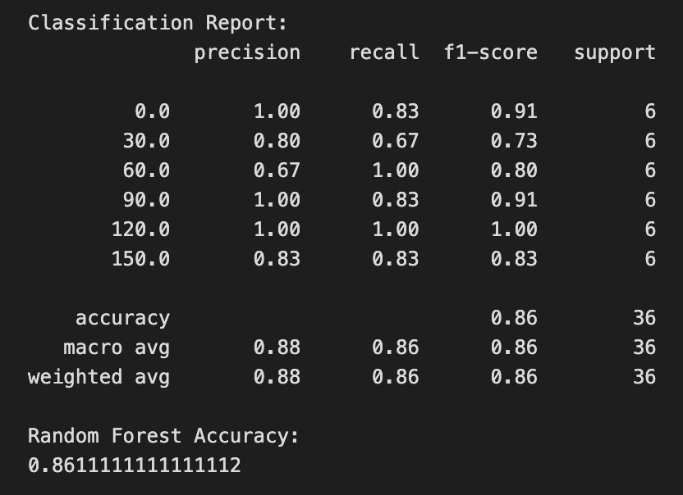
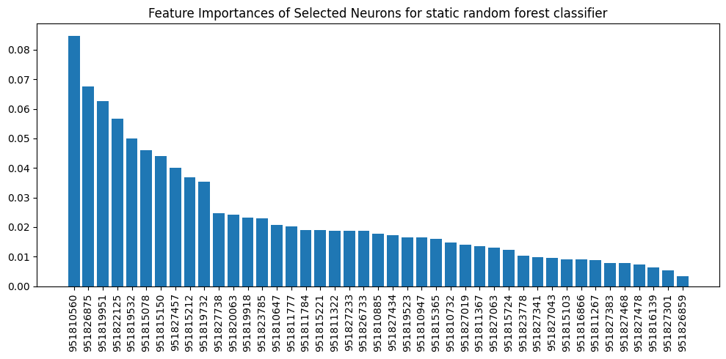
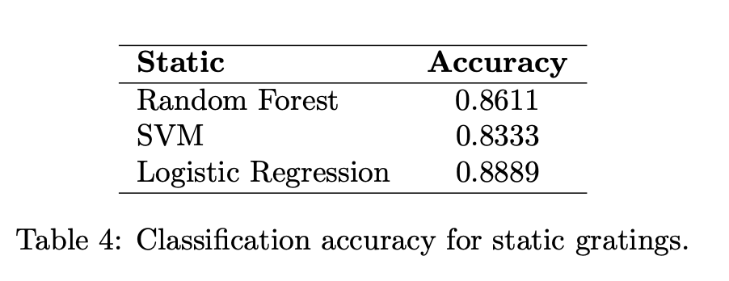
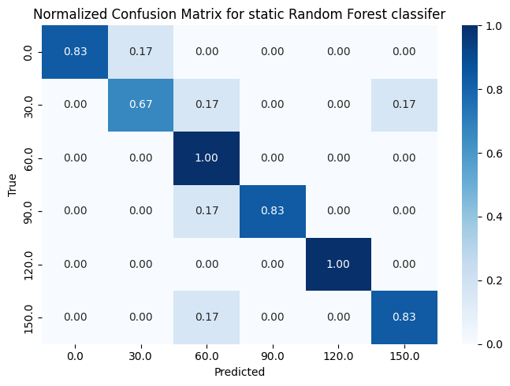
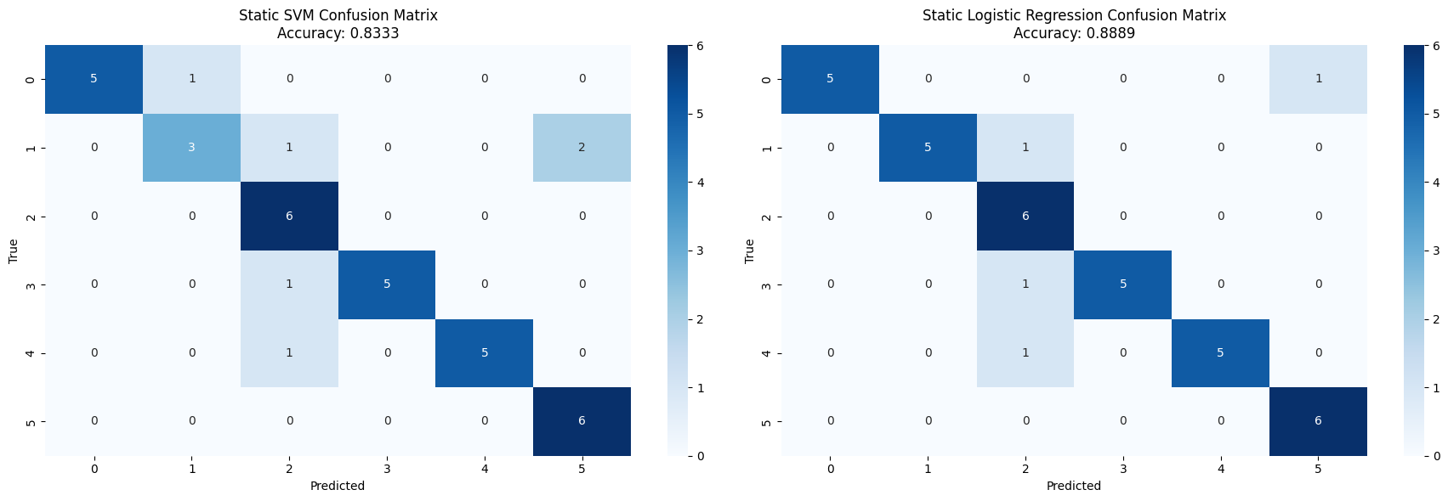
Static methods and results
Notes:
Using the spike counts of selected neurons, predict the orientation (6 distinct orientations - 8 orientationd drifting)
Constructed a feature matrix with stimulus presentations as rows and the spike counts of a selected neuron
Prior to model training features were standardized using z-score normalization to account for differences in baseline firing rates, the dataset was stratified and split into training-70 testing-30 sets to ensure proportional representation of orientation classes
20 stimulus presentations for static, whereas only 5 presentations
We wanted to choose simple models for interpretability, We then considered Random Forest Models, SVM linear kernel, and Logistic Regression Overcomplicating the model choice was not necessary for this exploration. Using both linear and nonlinear models

Slide 9
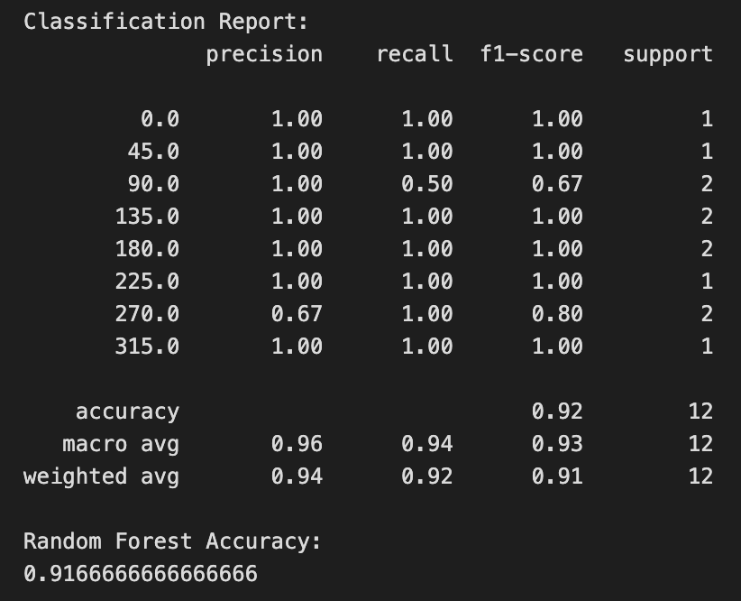
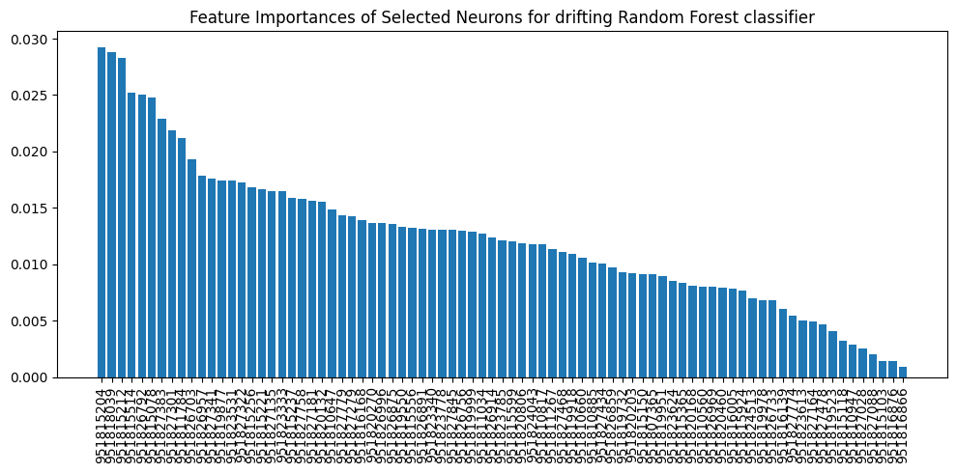
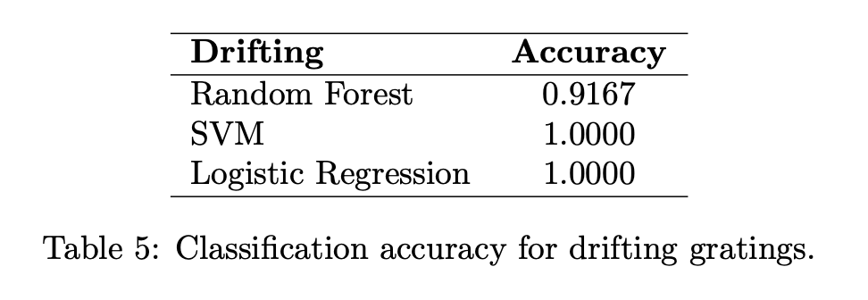
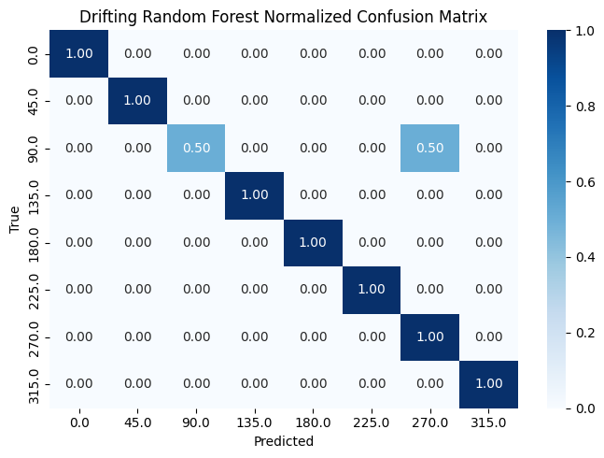
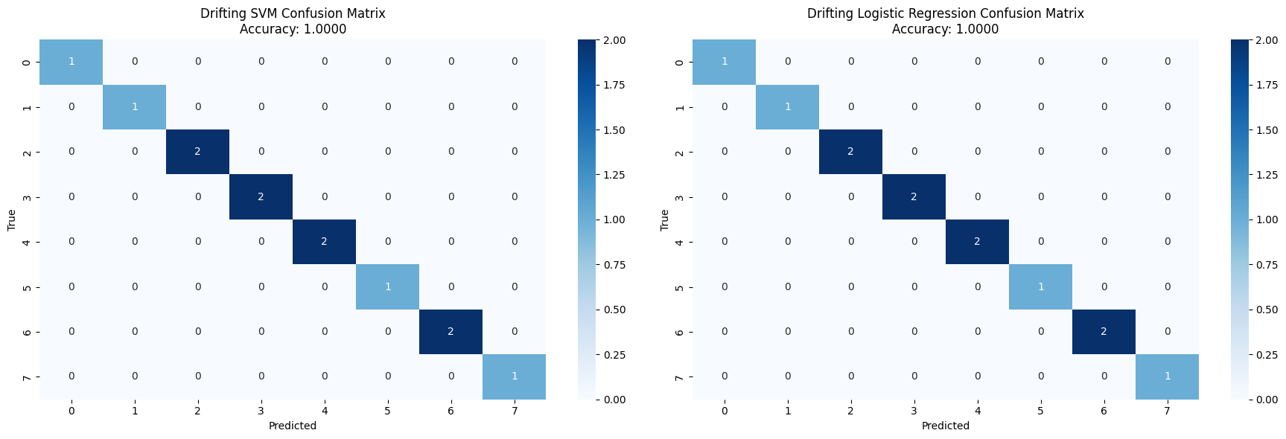
Drifting methods and results
Notes:
Using the spike counts of selected neurons, predict the orientation (6 distinct orientations)
Constructed a feature matrix with stimulus presentations as rows and the spike counts of a selected neuron
Prior to model training the dataset was stratified and split into training-70 testing-30 sets to ensure proportional representation of orientation classes
20 stimulus presentations for static, whereas only 5 presentations
Features were standardized using z-score normalization to account for differences in baseline firing rates
We then considered Random Forest Models, SVM linear kernel, and Logistic Regression
We wanted to choose simple models for interpretability, and suitability for small to medium-sized, high-dimensional datasets. Overcomplicating the model choice was not necessary for this exploration.
Logistic Regression: baseline linear model that is interpretable and effective when class boundaries are approximately linear, useful reference point for classification tasks involving neural spike counts.
SVM with a linear kernel was chosen for its ability to find a maximum-margin hyperplane, which often performs well in high-dimensional spaces, particularly when data is not perfectly separable but linearly distinguishable with regularization.
Random Forests offer a non-linear, ensemble-based approach that is robust to noise and can capture interactions between neurons that linear models may miss, without strong assumptions about data distribution.

Slide 10
Conclusions and limitations
Limitations:
Discrepancy in 𝚫θ
Difference in presentation count
Limited to a single session
Overlooked drifting temporal and static spatial patterns
Difference in nature of stimulus, in static spatial frequency and phase varies and in drifting temporal frequency varies. Ideally our analysis should keep these fixed.

